Slide 1
Controller
common
FrontController
member
MemberInsertServlet
cashdonation
allpay
MemberContentServlet
MemberModifyServlet
MemberTotalPointServlet
MemberModifyValueServlet
CashDonationListServlet
AllPayListServlet
AllPayContentServlet
CashDonationInsertServlet
CashDonationModifyStateServlet
AllPayInsertServlet
AllPayModifyStateServlet
MemberCheckLoginServlet

Slide 2
Controller
question
QuestionListServlet
talentboard
allboard
QuestionContentServlet
QuestionWriteServlet
QuestionModifyServlet
QuestionDeleteServlet
TalentBoardListServlet
AllBoardListServlet
AllBoardContentServlet
TalentBoardContentServlet
TalentBoardWriteServlet
TalentBoardModifyServlet
TalentBoardDeleteServlet
TalentBoardReplyServlet
TalentBoardStateServlet
TalentBoardConfirmServlet

Slide 3
Controller
admin
MemberListServlet
MemberDeleteServlet
CashDonationContentServlet
AllBoardWriteServlet
AllBoardModifyServlet
AllBoardDeleteServlet
DonationListServlet
DonationWriteServlet
DonationModifyServlet
DonationDeleteServlet

Slide 4
Service
member
MemberService
cashdonation
allpay
MemberServiceImpl
MemberVo
CashDonationService
AllPayService
AllPayServiceImpl
CashDonationInServiceImpl
CashDonationVo
AllPayVo

Slide 5
Service
question
QuestionService
talentboard
allboard
QuestionServiceImpl
QuestionVo
TalentBoardService
AllBoardService
AllBoardServiceImpl
TalentBoardServiceImpl
TalentBoardVo
AllBoardVo

Slide 6
Service
admin
AdminService
AdminServiceImpl
DonationListVo

Slide 7
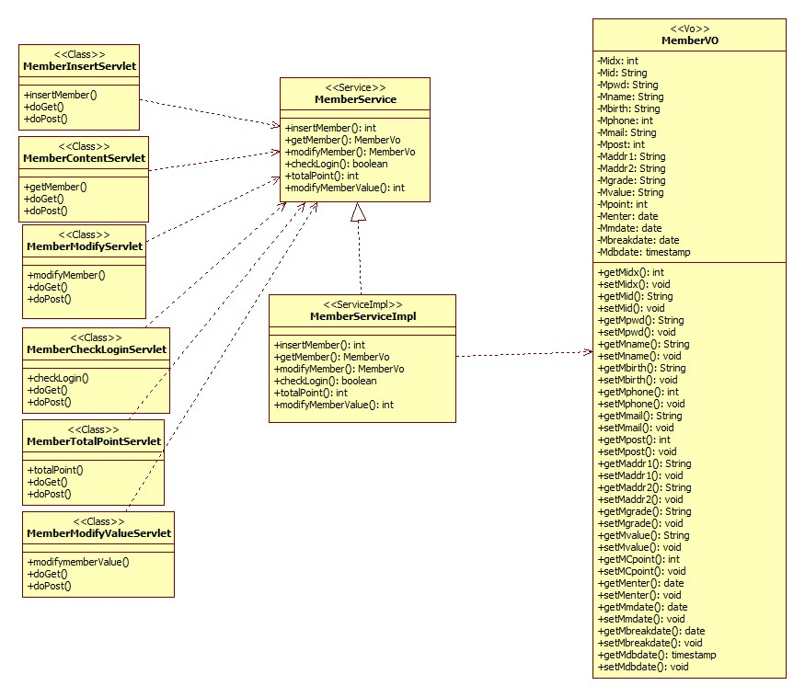
<member>

Slide 8
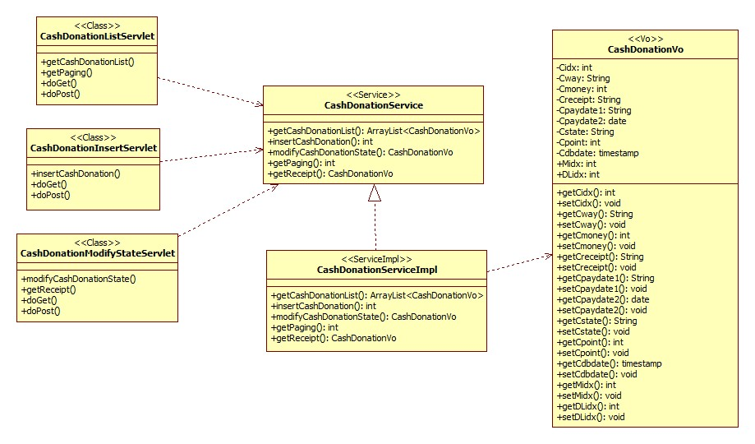
<cashdonation>

Slide 9
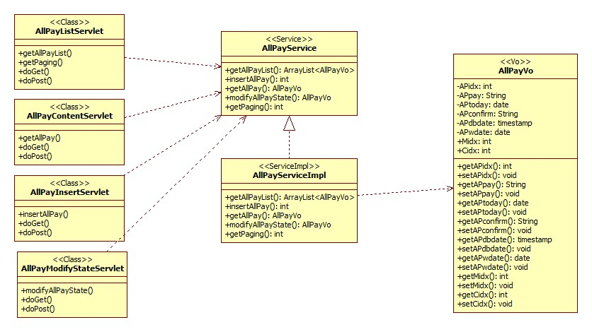
<allpay>

Slide 10
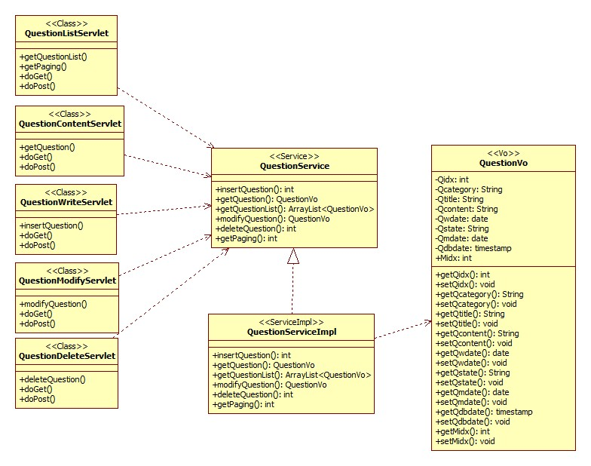
<question>

Slide 11
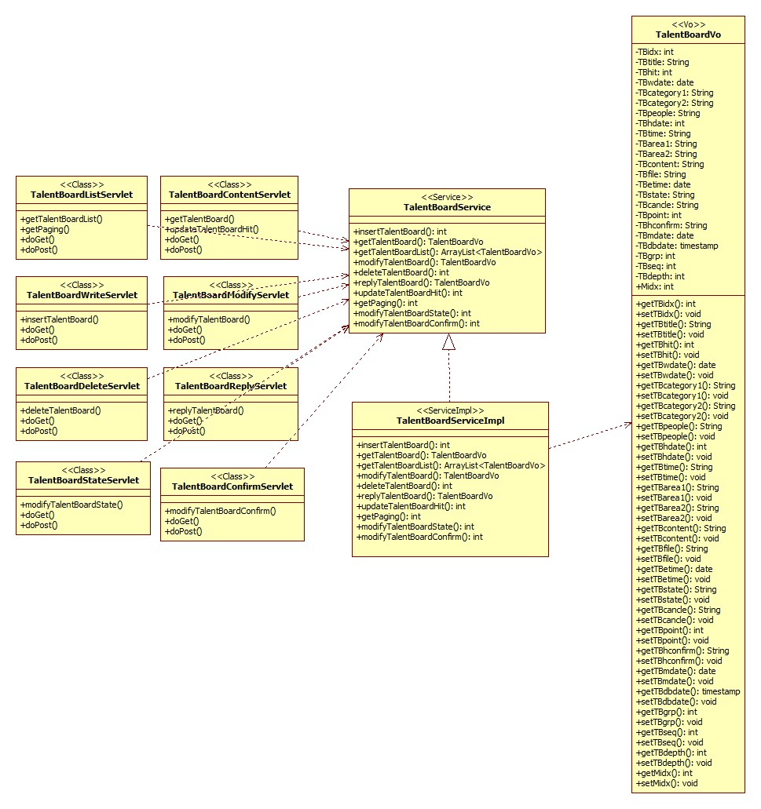
<talentboard>

Slide 12
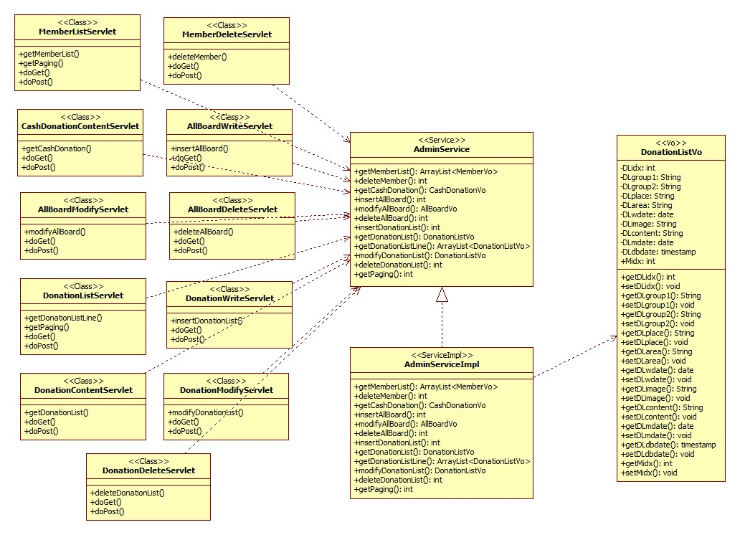
<admin>

